Slide 1


Welcome NEW IS Officers!
Monday, January 5, 2026
HAPPY NEW YEAR!!

Slide 2
AGENDA / Discussion
Welcome- Purpose of Meeting
Role of the IS Officer
IS Officer Resources
Forms Warehouse
How to Guides
IS Officer Job Aids
District Policies
Serving the Members & Staff (Reports)
Using List views to manage your work
Training

Slide 3

The IS Challenge

Slide 4
Role of the IS Officer
Collect and Report the Activity of Our Members
Encourage Members to Report (forms, email, or in AUXDATA II)
If submitted via form or email, make the entry in AUXDATA II.
Make sure reporting is consistent with the expectations of BSX (Chief Directors Office) see definitions.
Provide Information to Leadership to help decision making
Provide Information to Members
You will be asked about EVERYTHING!
Attend Flotilla and Division Meetings- Stay “in the know”

Slide 5
Role of IS Officer (continued)
We do NOT establish policy.
We can not dictate when Activity Logs must be submitted
We DO look at ALAUX and L2 POLICIES to see what is approved by the Chief Director’s Office.
Only policies approved by the Chief Director are valid.
“Rumors”, “Upcoming changes” or directives from other staff that are not in the approved policy should be referred back to the COLM.

Slide 6
IS Officer Job Descriptions
FSO-IS
Member Assistance/ Training
AUXDATA Entry if needed
Quality Review of entered data
Informing Leadership of accomplishments (Reports)
Informing Members of deadlines
SO-IS
FSO-IS Assistance/ Training
AUXDATA Entry if needed
Quality Review of Entered Data
AUXDATA Activity Log Approval (AUX-10 Required for permissions)
Informing Leadership of accomplishments (Reports)
Informing Members of deadlines

Slide 7
IS Officer Resources
People Resources
Your SO-IS, ADSO-IS or DSO-IS
Materials/ References
“ U” Directorate web page
Forms Warehouse
How to Guides
IS Officer Job Aids
District (DIRAUX) Policies

Slide 8
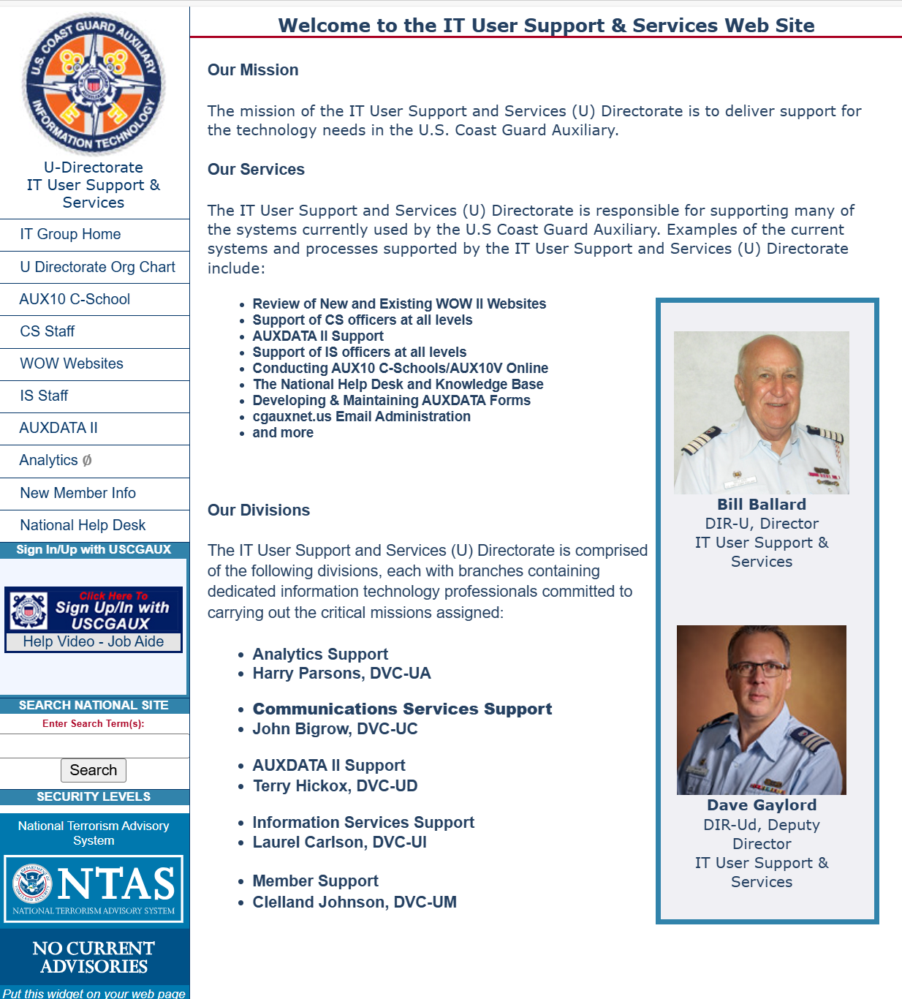
U Directorate: https://wow.uscgaux.info/content.php?unit=u-dept
New CS/IS Staff Page

Slide 9
Forms Warehouse
https://forms.cgaux.org/
PDF Forms Page:
7030 - Mission Codes and Descriptions
ALL Activity Codes (7029, 7030, 7038, 7046)
Official definitions for each code

Slide 10
How to Guides
http://wow.uscgaux.info/content.php?unit=IT-GROUP&category=auxdata-ii
AUXDATA II Page
Log in using Member Number and Member Zone Password
How To Guides provide more explicit definition of how mission codes are used
22 Guides
How to Guide also “walks through” the process of data entry
4 Quick Guides for some programs- training for members

Slide 11
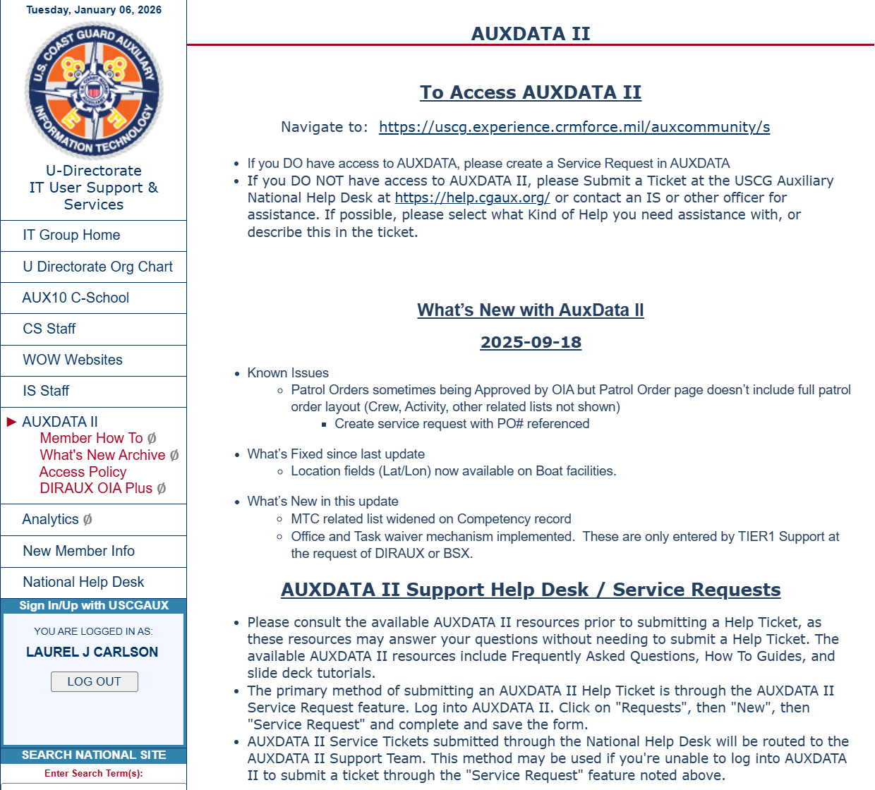
IS Officer Job Aids
IS Officers
IS OFFICER FOLDER

Slide 12
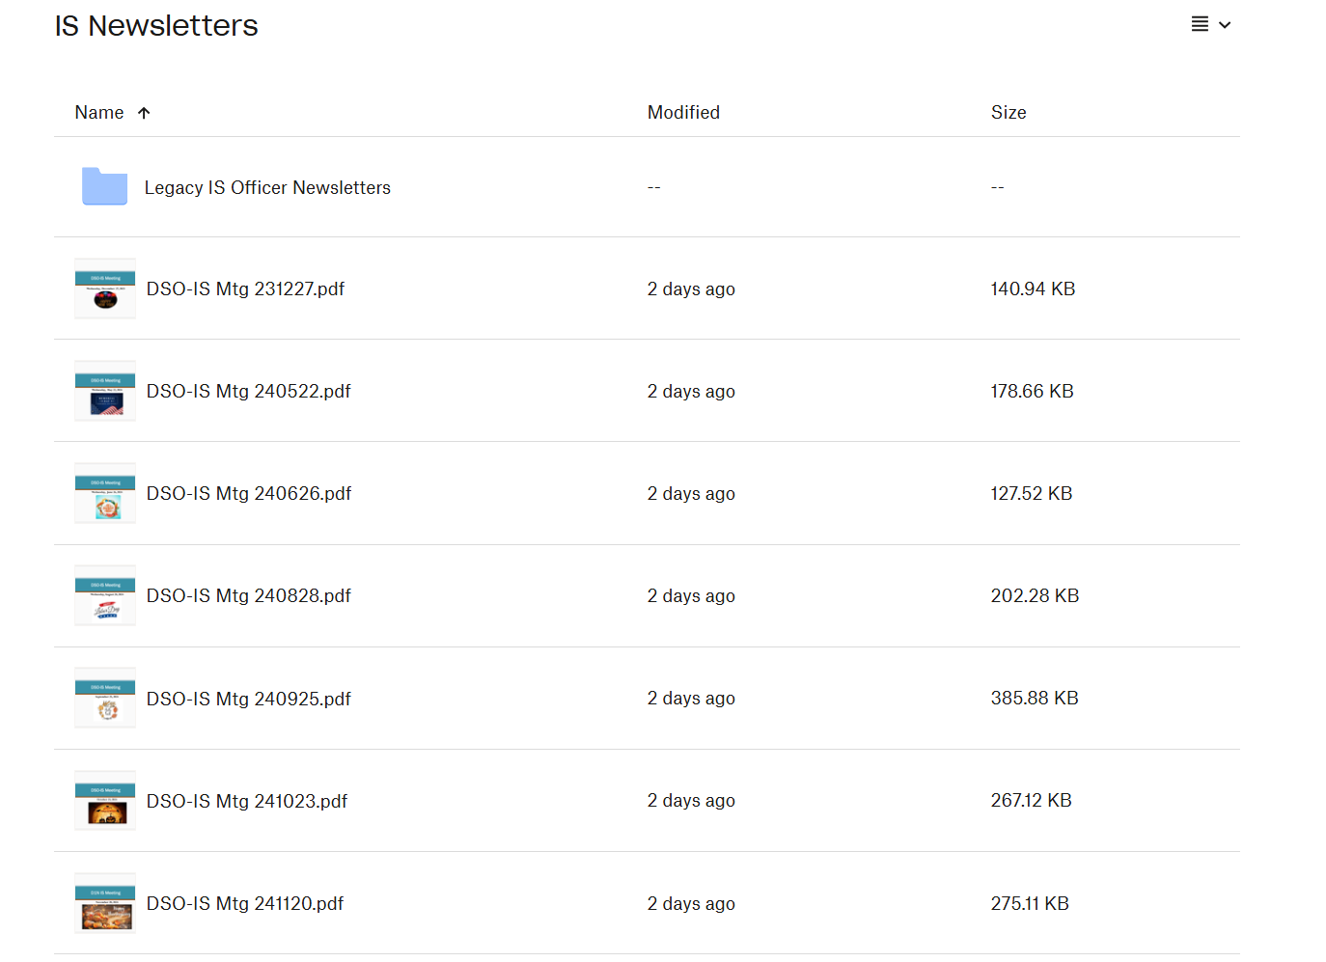
IS Officer Job Aids
IS Newsletters – Dropbox

Slide 13
District Policies- Your District
Each District has a policy on where various documents are entered and who does the entry.
Look at your District Webpage for DIRAUX Forms, a Form Flow Guide or a Help Desk Link
Know what you should enter or update in AUXDATA II and what you should NOT be updating.
Know how to route various forms, certificates or request to the correct place for entry.

Slide 14
Serving Your Members and Leadership
Member Records
Contact Lists
Reports
QUICK STOP REPORTS in AUXDATA
See Index of reports in How to Guide
Start Providing Reports at Meetings

Slide 15
Good Reports to Share
For Leadership:
Member Unit Hours
Mission Details (#VSC, PV, Graduates from PE, etc.)
Member Training Status (REYR, Certified)
Contact Lists (Membership, Officers)
For Members
Member Hours
Mission Details (#VSC, PV)
Upcoming Deadlines for Core Training or TCT
Member Training Records

Slide 16
Location of Key Reports in Quick Stop
Contact Lists
Member Contact Sub-folder
Member Unit Hours and Unit Detail Data
Unit Summary Subfolder
Member Competencies and Tasks and Task Deadlines
Competency & Training Subfolder
Member Training Record
Member Information Subfolder
Simplify your life and make bookmarks in your Browser for reports you will be needing often

Slide 17
Manage your Activity Log Review
Make LIST VIEWS to expedite your review
On the Activity Log “Recently Viewed” page, click the down arrow and select one of the “GEN” formats and Clone it. Alter the filters as needed. (See How To Guide on List Views)
List Views that you should have:
Activity Logs awaiting Review
Activity Logs in OPEN, UNDER REVIEW or NEEDS Clarification Status

Slide 18
Training Opportunities
See if there will be IS Training at your DTrain (or another District DTrain or VTrain)
Talk to your SO-IS about Training
National Training:
AUX-10 C-School (in person or Virtual)

Slide 19
National “U” Directorate Resources
IS Officer Seminars (once a month):
60-90 minutes with a specific focus such as:
Data QC
Reports
Patrols and Facility Inspections
Etc.
Don’t be shy about asking questions!!!!

Slide 20
QUESTIONS/ Follow-up

